Slide 1

Final Project: Asbestos Inspection Robot Robotics (Theory, Practice, Philosophy)
Ka Hei Pinky Chow, Bryony Bar

Slide 2
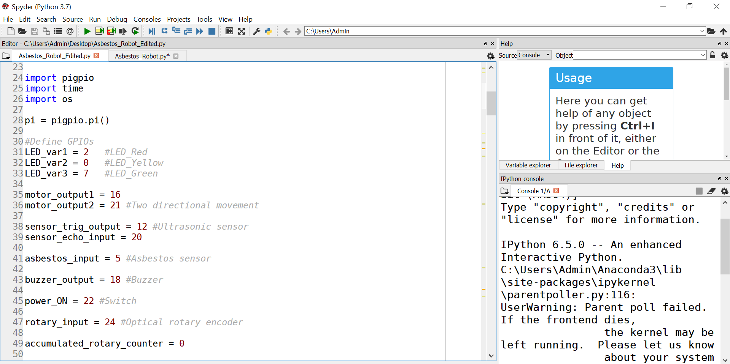
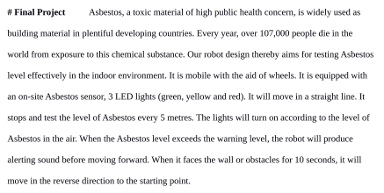

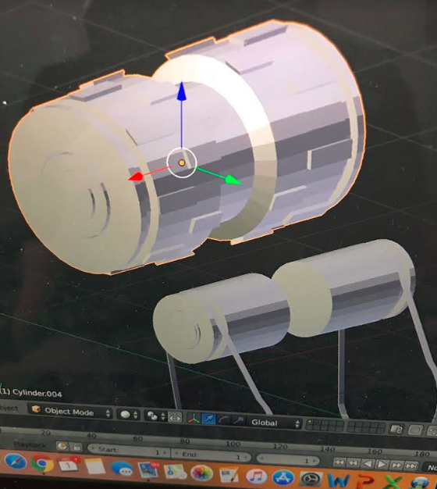
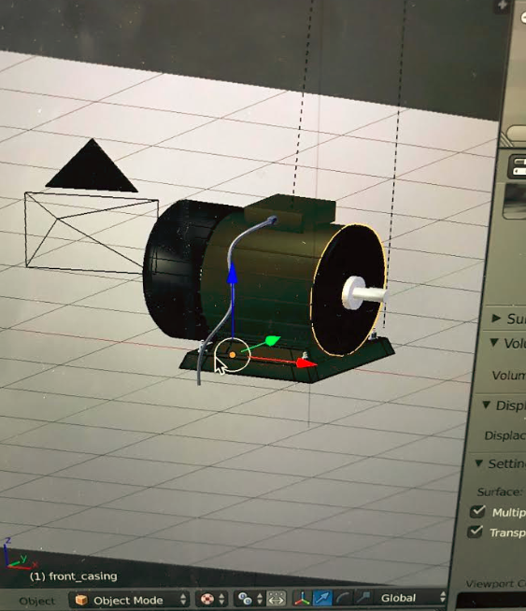
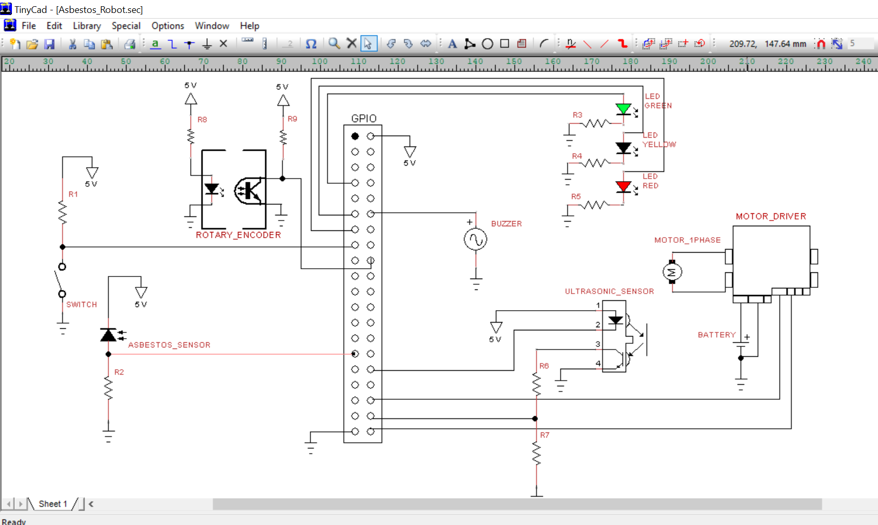

Slide 3
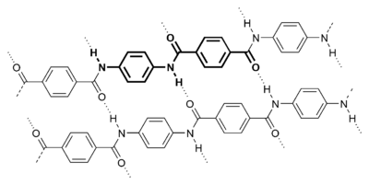
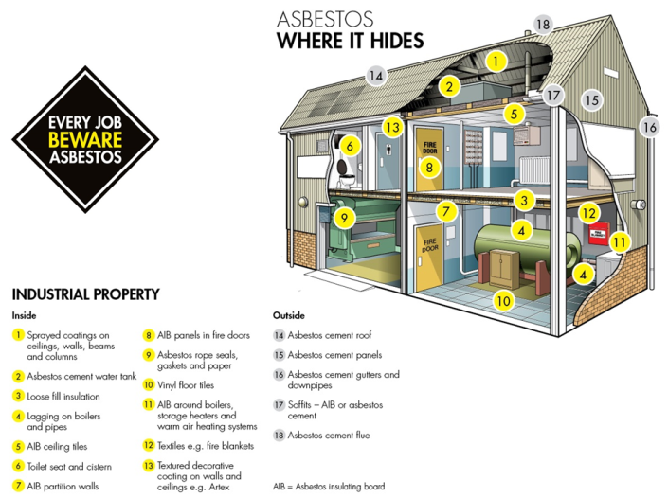
Background
Asbestos (Mg₃Si₂O₅(OH)₄):
Naturally occurring silicate minerals
Known carcinogen and causes mesothelioma when inhaled
Used as fireproofing material to construct buildings (floor, ceilings, pipes, insulation...)
More than 107,000 people die in the world each year from exposure to asbestos.

Slide 4
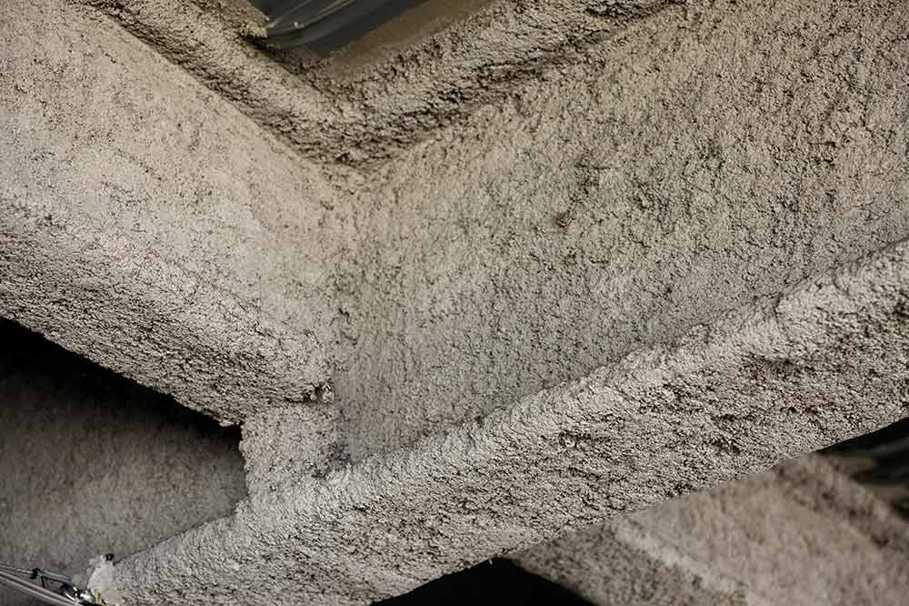
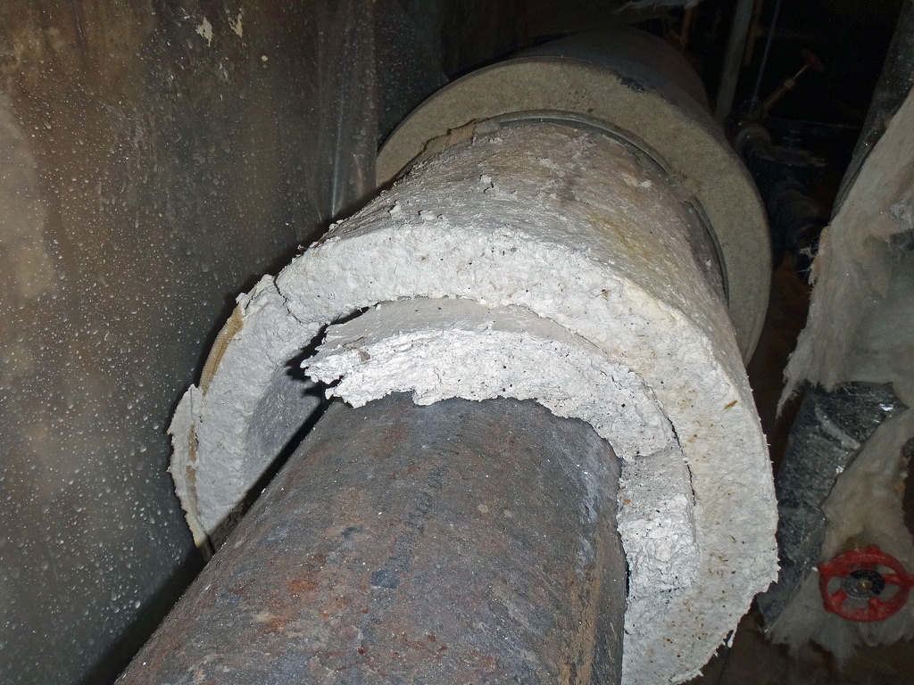

Idea for our final project
?
# Two-wheeled mobile robot
# Working in indoor environment
# Autonomous testing in buildings
# For authority to assess environmental risk for public health

Slide 5
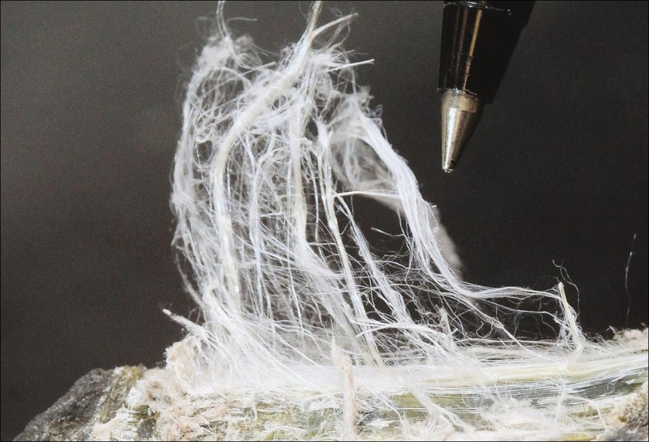
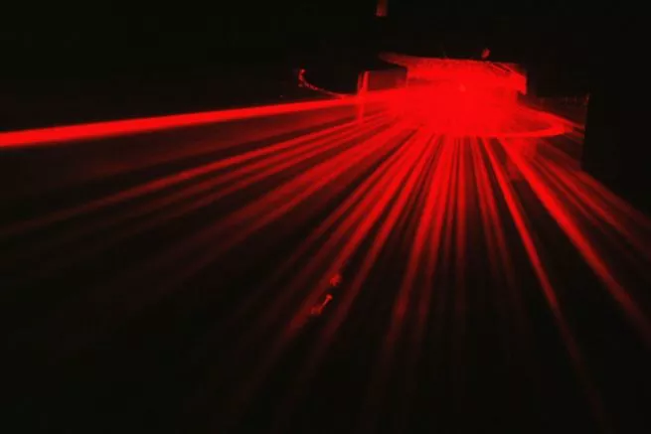
How to test Asbestos?
# Shine a laser on a stream of airborne particles
# Analyze the reflected light pattern
# Pull the stream of airborne particles through a magnetic field
# If the fibers align with the magnetic field

Slide 6
Functions of our robot design
1
Modified Obstacle Detection
2
Autonomous sampling and return
3
Asbestos level testing
The robot will constantly detect obstacle;
Multiple measurement is considered for better accuracy;
Temporary obstacle will not hinder robot’s performance
Systematic distance sampling and returning to the starting point
Rotary encoder
Measure travelled distance
Adjusted behaviors
Inspection of Asbestos level
Warning system: Alerting sound and LED Lights

Slide 7
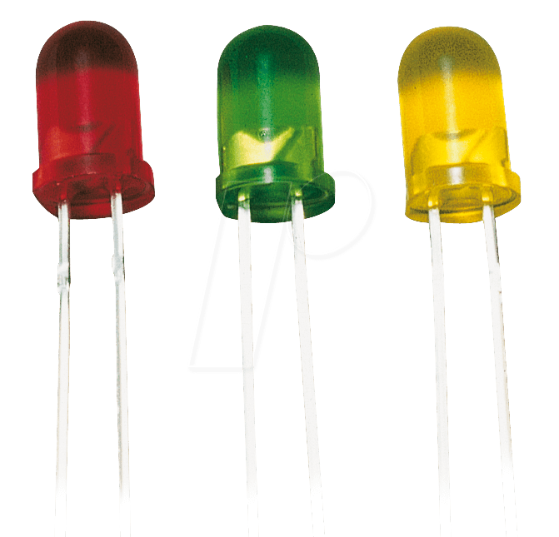
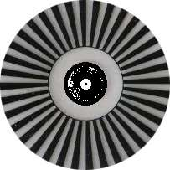
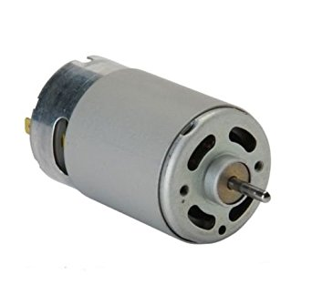
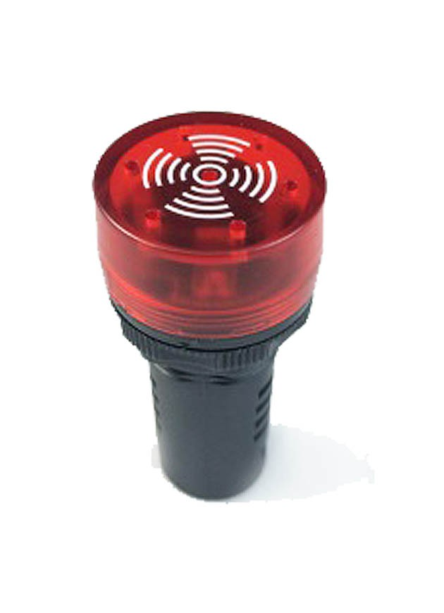
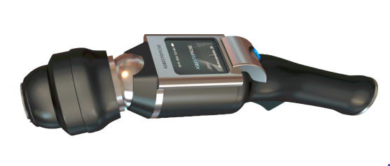
Components
Raspberry Pi; Battery
Inputs:
Ultrasonic sensor
Asbestos sensor
Switch
Rotary encoder
Outputs:
Motor
LED lights
Buzzer

Slide 8

Schematic Diagram
# TinyCAD
Components connected to the Raspberry Pi via pin GPIO.

Slide 9
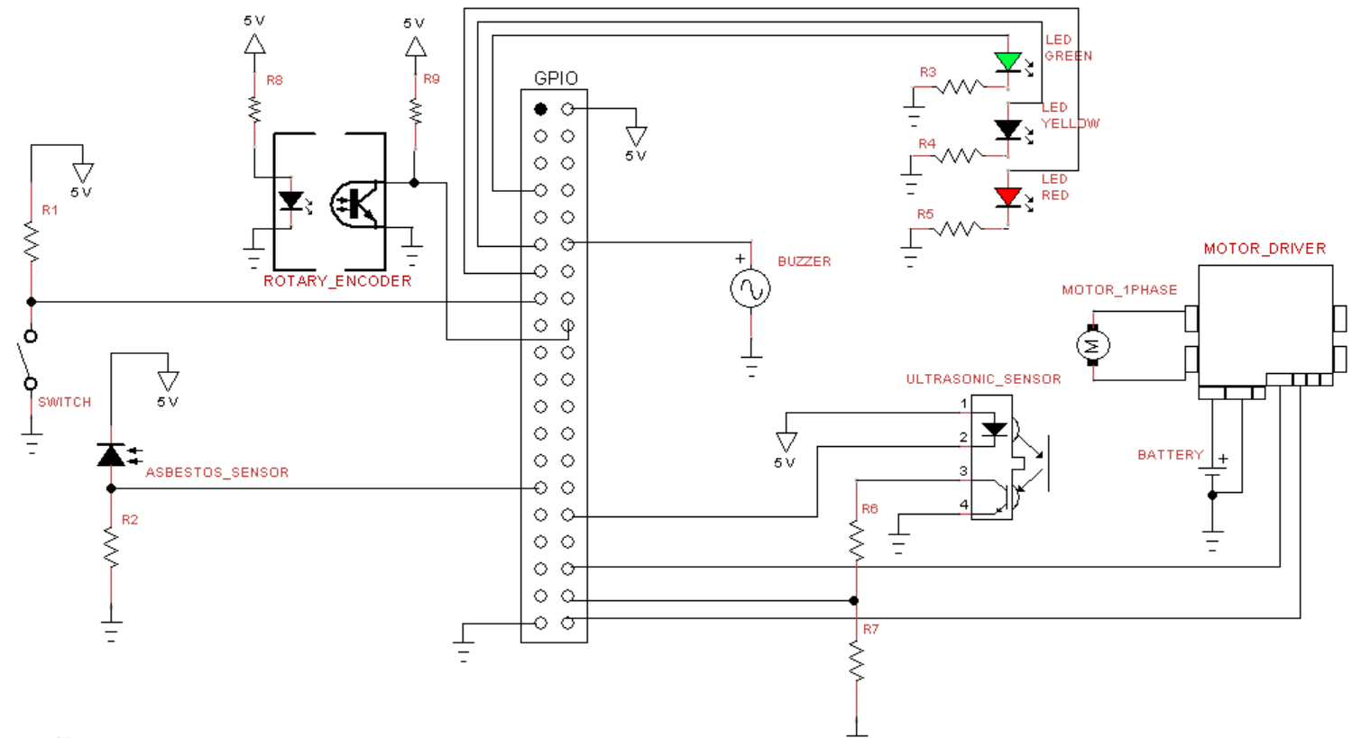

Slide 12
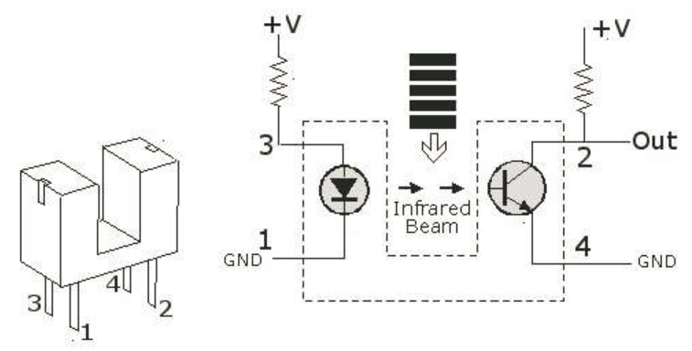
Rotary Encoder
# Optically measures how far something has moved
# LED & a Photo Diode mounted facing each other
# Light emitted by the IR LED is blocked because of the alternating slots of the encoder disc
# Conduction level changes

Slide 16
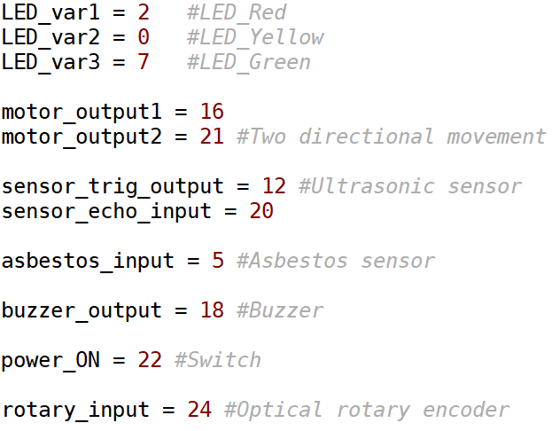

Slide 17
Python Coding
Operation process:
Ultrasonic sensor - Constantly testing obstacle
Measuring distance - Rotary sensor
Sampling - Stop every 5 metres and initiate asbestos sensor; different response according to results
Return to the starting point when finished
Functions:
process_sampling()
process_asbestos_sensor()
process_ultrasonic_sensor()
detect_obstacle()
power_off()

Slide 18
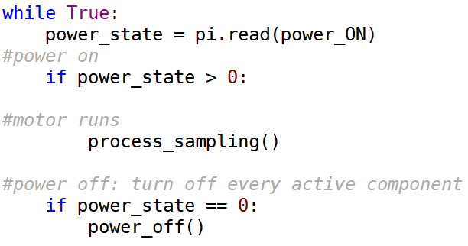
Python Coding
Operation process:
Ultrasonic sensor - Constantly testing obstacle
Measuring distance - Rotary sensor
Sampling - Stop every 5 metres and initiate asbestos sensor; different response according to results
Return to the starting point when finished

Slide 19
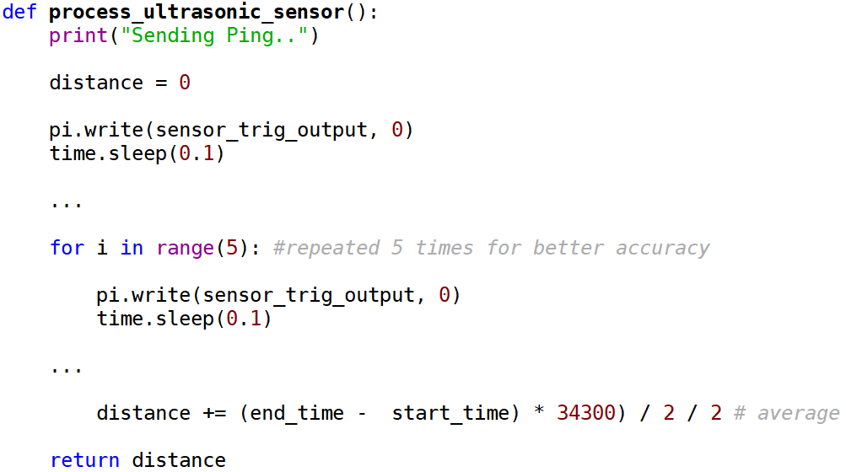
Python Coding
Operation process:
Ultrasonic sensor - Constantly testing obstacle
Measuring distance - Rotary encoder
Sampling - Stop every 5 metres and initiate asbestos sensor; different response according to results
Return to the starting point when finished

Slide 20
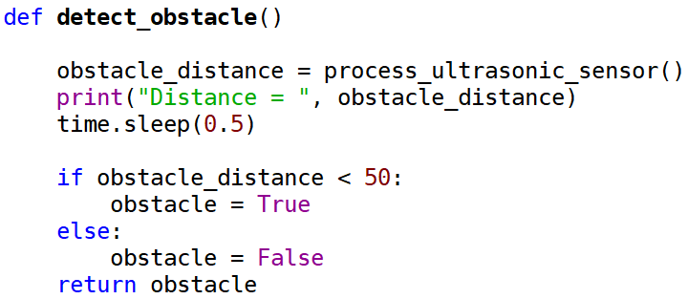
Python Coding
Operation process:
Ultrasonic sensor - Constantly testing obstacle
Measuring distance - Rotary encoder
Sampling - Stop every 5 metres and initiate asbestos sensor; different response according to results
Return to the starting point when finished

Slide 21
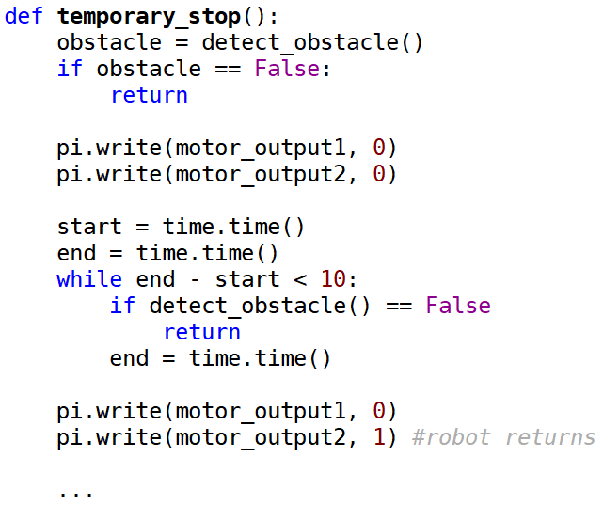
Python Coding
Operation process:
Ultrasonic sensor - Constantly testing obstacle
Measuring distance - Rotary encoder
Sampling - Stop every 5 metres and initiate asbestos sensor; different response according to results
Return to the starting point when finished

Slide 22
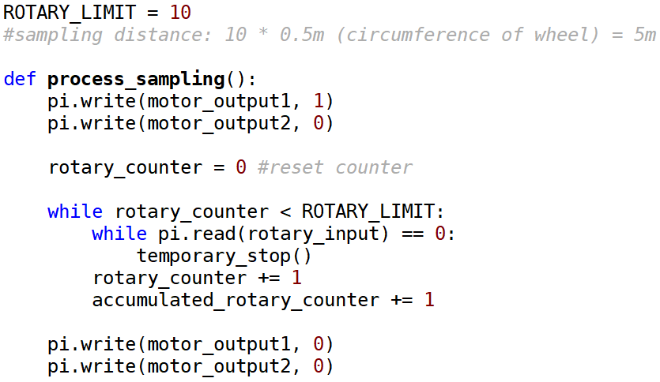
Python Coding
Operation process:
Ultrasonic sensor - Constantly testing obstacle
Measuring distance - Rotary encoder
Sampling - Stop every 5 metres and initiate asbestos sensor; different response according to results
Return to the starting point when finished

Slide 23
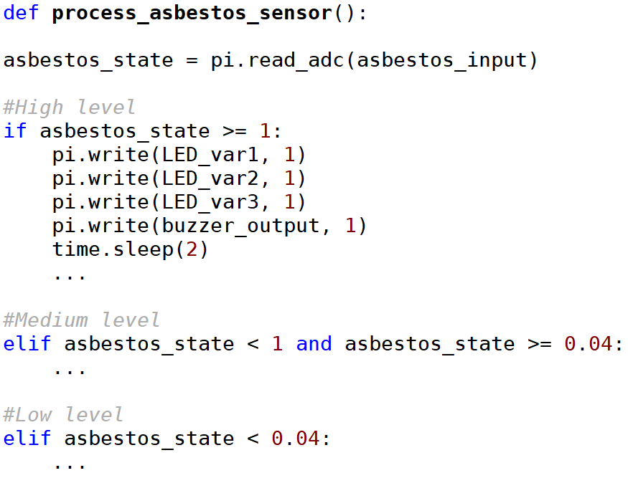
Python Coding
Operation process:
Ultrasonic sensor - Constantly testing obstacle
Measuring distance - Rotary encoder
Sampling - Stop every 5 metres and initiate asbestos sensor; different response according to results
Return to the starting point when finished

Slide 24
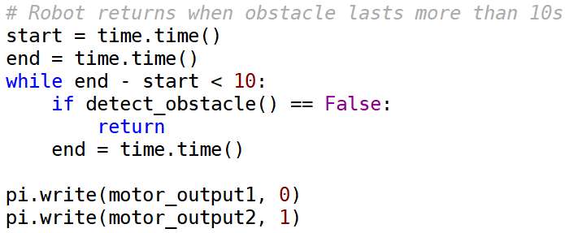
Python Coding
Operation process:
Ultrasonic sensor - Constantly testing obstacle
Measuring distance - Rotary encoder
Sampling - Stop every 5 metres and initiate asbestos sensor; different response according to results
Return to the starting point when finished

Slide 25
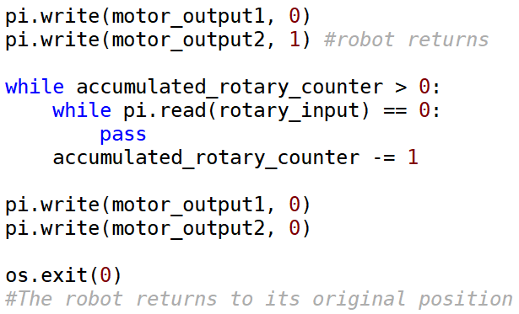
Python Coding
Operation process:
Ultrasonic sensor - Constantly testing obstacle
Measuring distance - Rotary encoder
Sampling - Stop every 5 metres and initiate asbestos sensor; different response according to results
Return to the starting point when finished

Slide 26
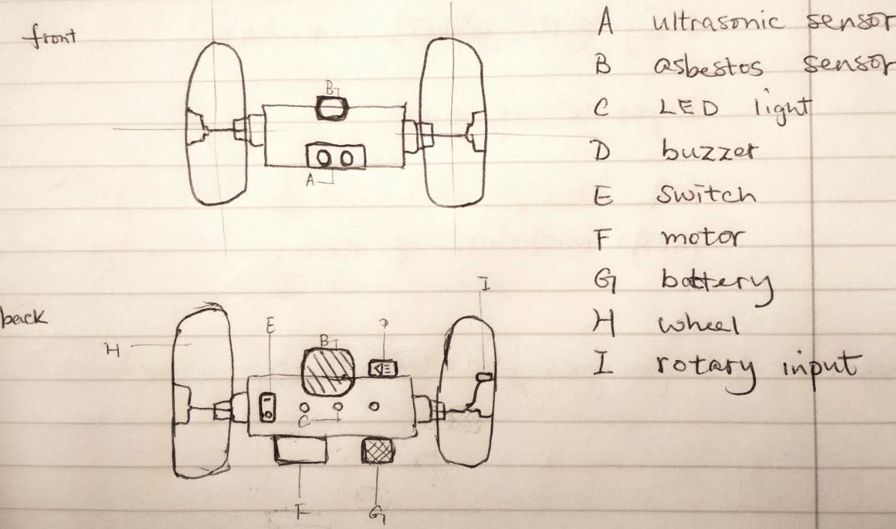
Graphic Design
Two wheels, one with rotary encoder attached
Asbestos sensor and ultrasonic sensor attached on the main body in the front
Response area for LEDs and buzzer
Other components inside the body

Slide 27

# Blender
...for our robot graphic design

Slide 28
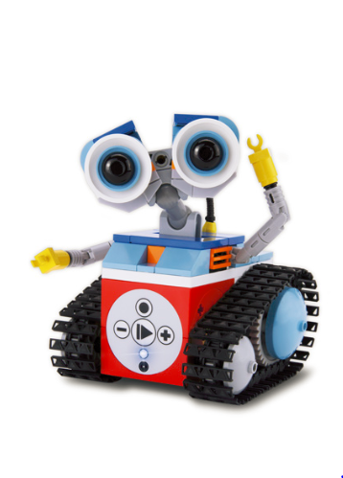
The END
Thank you for Reto’s and tutor’s help for our project and
all of your attention!

